Slide 1
Comparative Analysis on Storage and Analytics Technologies

Slide 2
SQL Server
Pros
Enterprise Wide Solution
MPP Technology Supported
Transact SQL, ANSI SQL Supported
Supports Complex Business Queries and Joins
Recommended for Offline (Batch) Analytics
Recommended for Transactional System.
Recommended for Traditional EDW System.
High Skillset Availability
Synchronous INSERT and UPDATE
High Maturity and Stability
Pre-Configured Security.
Vertically Scalable
Supports Immediate Consistency
Supports Both Primary and Secondary indexes.
Huge Community
Unlimited Record Update Supported.
Microsoft Products Compatibility
No record size limitation
Bulk Insert Support
Query caching
SSL/TLS support
Unicode support
Cons
Not Open Source
Huge Corporate Licensing Cost
More expensive initial cost
Huge Hardware Cost. Can not run on Commodity Hardware.
Fixed Schema Architecture (Schema on Write)
No High Availability
Not Suitable for Rapid Development Due to fixed Schema
Supports structured data only
Not Suitable for Volume and Variety of Data
Not Recommended for Micro services
Difficult to Learn
Not Horizontally Scalable
Difficult to Manage and Administer (DBA is Required)
Huge Volume reduces Performance
Limited Replication Support
No Hadoop (Data Lake) Support
Not suitable for VLDB (Very Large Database) Solutions.
Hardware resource intensive.
No Bulk Update Support

Slide 3
MongoDB
Pros
Open Source
Enterprise Wide Solution
MPP Technology Supported
Rich Document Model
Free and Corporate Licensed Version Available
Less expensive initial cost
Less Hardware Cost. Can Run on Commodity Hardware.
Dynamic schema (Schema on Read)
Auto Sharding Support
Native replication support
In-memory speed
Easy to Develop
Suitable for Rapid Development due to Dynamic schema
SQL Support available through Third Party SQL Wrappers.
Supports Diverse Data (Structured, Semi-Structured and Un-Structured Data)
Powerful Analytical Capabilities over high volumes of multi-structured data sets
Powerful Query Functionality
Strong volume and variety handling capabilities.
Recommended for Online (Real-Time) Analytics
Recommended for Advanced and Big Data Analytics.
Hadoop (Data Lake) Supported
Horizontally Scalable Architecture
Recommended for Micro services
Asynchronous INSERT and UPDATE
Bulk Insert Support
Bulk Update Support
Less Maturity and Configurable Stability: Depending on Write Concern Values it could be faster with less reliability or slower with more reliability
Easy to Manage and Administer (DBA not Required)
Supports immediate Consistency as well as Eventual Consistency
Provides High Availability
Supports Both Primary and Secondary indexes.
Recommended for Huge Volume Handling
Replication Supported
Growing Community
Suitable for VLDB (Very Large Database) Solutions.
Not hardware resource intensive.
JSON, XML, BSON Documents Support.
SSL/TSL support
Unicode Support

Slide 4
MongoDB
Cons
No Direct SQL Support.
Performance issues with Third Party SQL Wrappers.
Complex Business Queries and Joins are not Recommended
Low Skillset Availability
Maximum of 1000 Documents update supported in a single process/transaction.
Limited Microsoft Products Compatibility.
Time taking Configuration Process.
Maximum Document size in 16MB.
Security is not Pre-Configured.
No Query caching

Slide 5
BI on MongoDB
MongoDB Connector for Business Intelligence
Pros
Use your favourite BI platforms to access your MongoDB cluster directly, allowing you to generate insights quickly and with less effort.
The BI Connector is compatible with many popular BI and analytics platforms. Use MongoDB as a data source for Tableau, Excel, MicroStrategy, Microsoft Power BI, Qlik, and many more.
Remove the need for complex ETL processes that move data from MongoDB into other systems for analysis.
Reduce the performance impact of analytical workloads on other applications that rely on the same database by directing queries from the BI Connector to a secondary within your cluster.
Online Analytics - Real time
Cons
BI Connectors are not optimized for performance.
We rely on BI Connector functionality limitations.
BI connector are not free.

Slide 6
BI on SQL Server
Pros
Get maximum performance
Compatible with all popular BI analytical tools like SSAR,SSRS , PowerBI, Tableau and many more
Strong Semantic Layer support
Generate reports and visualize data without using any 3rd party connectors
Offline Analytics - Near Real time/Micro batch
Support complex business rules (semantic layer /reporting level)
Huge community
Strong official support
Recommended for structured data
Cons
For structured data only
Fixed schema dependency
Online analytics is not supported

Slide 7
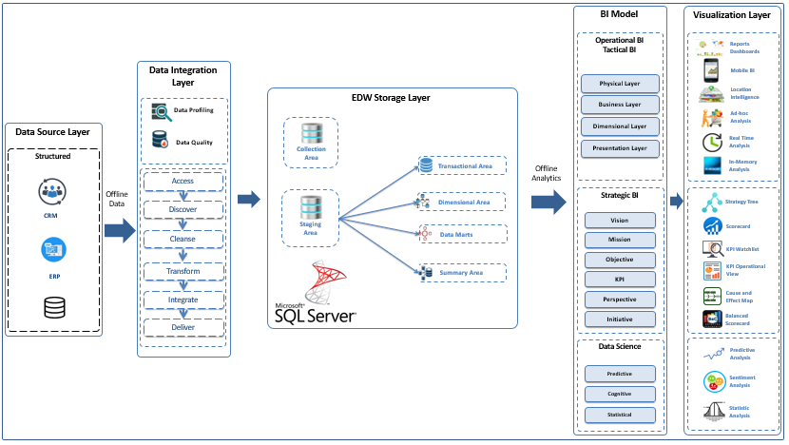
Architecture
Traditional EDW

Slide 8
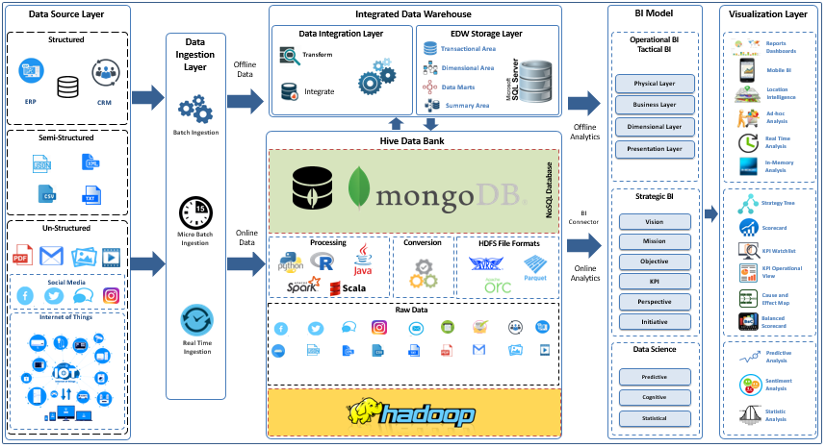
Architecture
Modernized EDW Approach

Slide 9
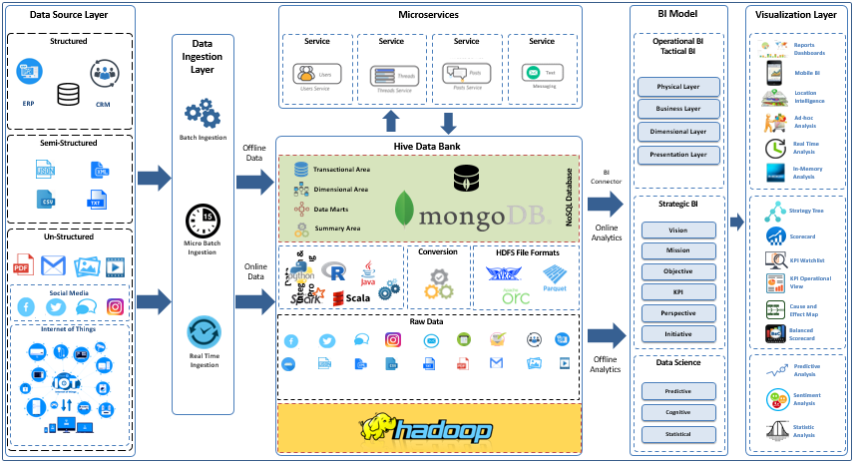
Architecture
Advanced EDW Approach

Slide 10
Use Cases
Traditional EDW Solution
A manufacturing organization planning to use its CRM, ERP, Booking, Sales and Issuance data stored in RDBMS to generate detailed insights about their business for better Business Planning.
Modernized EDW Approach
Retailers using Traditional EDW already and planning to extend their solution for tracking user preferences, web clicks, and social sentiment to identify and automatically target geo-aware and device-aware personalized content and promotions
The City Administration uses MongoDB to pull together millions of data points across its most crucial departments, providing real-time data analysis to city managers so they can better predict and allocate resources, respond quickly to emergencies, regulate traffic flow and uncover trends that would have otherwise been invisible.
Advanced EDW Approach
An online retailer, generates some 10,000 events per second. Every click and hover of every mouse is stored in MongoDB, and real-time data analytics is used to provide unique and personalized web experiences to individual visitors.
Media company uses MongoDB to pinpoint when content is viewed, where it’s shared, and how it’s being consumed by its 400 million monthly website visitors. The system enables BuzzFeed’s employees to analyze, track, and display these metrics to writers and editors.

Slide 11
Requirement vs. Implementation Technology
Requirement |  | SQL Server | MongoDB | Hadoop
Licensing and Cost | Free | NA | A | A
Technology | Open Source | NA | A | A
 | MPP Technology | A | A | A
Third Party Products Support | Microsoft Stack | A | NR | NR
Solution Type | Transactional System | A | A | NR
 | Traditional EDW | A | NR | NR
 | Big Data and Advanced Analytics | NA | A | A
Hardware | Commodity Hardware Support | NA | A | A
Data Type | Structured | A | A | A
 | Semi Structured | NA | A | A
 | Unstructured | NA | NR | A
Data Schema | Flexible | NA | A | A
 | Static | A | A | A
Analysis Type | Online Analytics | NA | A | NR
 | Offline Analytics | A | NR | A
SQL Support | Direct Support | A | NA | A
 | Third Party Connectors | A | A | A
Query Support | Complex Joins | A | NR | A
 | Complex Business Queries | A | NR | A
Data Handling | Volume | NR | A | A
 | Variety | NA | A | A
 | Velocity | NR | A | A

Slide 12
Datalake – using Hadoop
Pros
Recommended for Datalake Implementation due to
Optimized File System (Compression, File Format Conversions)
Distribution - Processing Power"
Cost Effective for Cloud Implementations
Cons
High Datalake failure ratio due to Bad Planning.
Rapidly changing technology
Tools get deprecated rapidly
New tools releasing at a rapid rate
Extensive Administration and Support Requirement
Time consuming process
Totally manual administration

Slide 13
Hadoop vs. MongoDB
 | Apache Hadoop | MongoDB
Written In | Java | C++
Open Source | Yes | Yes
Type | Framework | Database
OS | Cross-Platform | Cross-Platform
State | Suite of Products | Stand-Alone Product
Best Application | Large Scale Processing | Real-Time Extraction and Processing
MapReduce | Available | Available
Scalability | Limited | Yes
NoSQL | No | Yes
High Availability | Limited – Only One Failure Point Available | Yes – Replication Enabled
Storage | File System Available | File System Available
Server-Side Script Execution | Yes | Yes
Data Structure | Flexible | Only CSV and JSON can be imported
RDBMS System | Supplements RDBMS for specific Use Cases. Not Designed to Replace RDBMS | Designed to Replace RDMS, Supports RDBMS for specific Use Cases
Framework | Consists of different software, e.g. HDFS and MapReduce. | Stores data in collections.
Strength | Big Data Handling | Robust, More Flexible than Hadoop.
 |  | RDBMS Replacement
 | Batch Processing and Long Running Jobs | Real Time Data Processing and Analysis
Designed | It is a database, Primarily designed for data storage and retrieval. | Designed to process and analyze huge volume of data.
Weakness | It depends mainly on ‘NameNode’, which is the only point of failure | Major complaint regarding MongoDB is fault tolerance issue, which can lead to data loss.
Hardware Cost | Cost is more as it is a collection of software. | Cost effective because it is a single product.
Memory handling | It has the ability to optimize space utilization, which MongoDB lacks. | Efficient in handling memory as it is written in C++

